Slide 1
Quantum inspired Trajectory Flow matching (QTFM)
LoCo Quantum Team
Ran Xue, Zhuo Cao, Mira Sharma and Zhongyi Jiang

Slide 2

OUtline
PK/PD Problem
Trajectory Flow matching
Quantum inspired TFM
Results & Outlook
Our Team

Slide 3

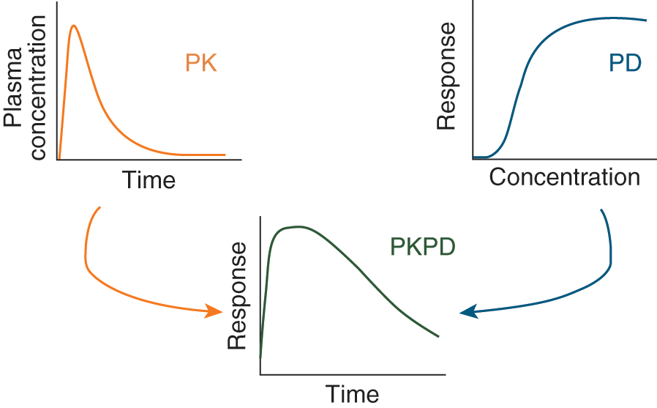
Pk/PD Problem
A dynamical system to be understood with limited clinical data.

Slide 4
Our Approach
Quantum inspired - trajectory flow matching (TFM)

Slide 5

WhY TFM?
Motivation:
Clinical data (i.e. time-series of bio-marker) = irregular, limited, noisy.
Conventional models (RNN, neural ODE/SDE) struggle with irregular sampling and simulations overhead.
Core idea:
TFM learns a continuous time-flow field from the patient trajectories (irregularly sampled data).
Training process is simlutation-free i.e. no need of back-propagation.
The learned flow field (i.e. how bio-markers evolve over time) enables continuous-time inference.

Slide 6
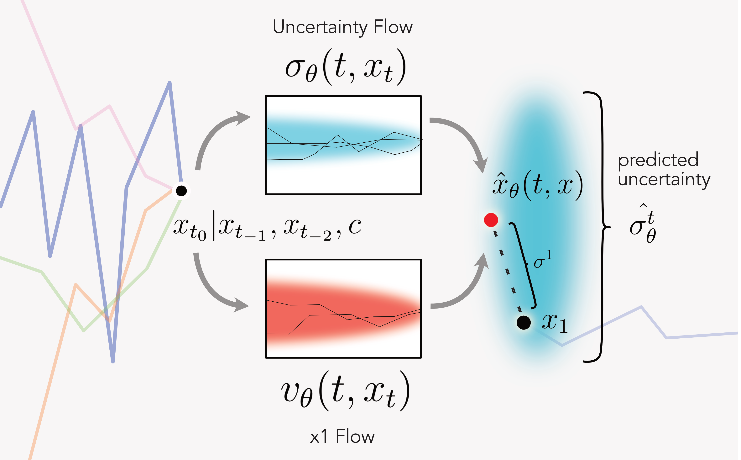
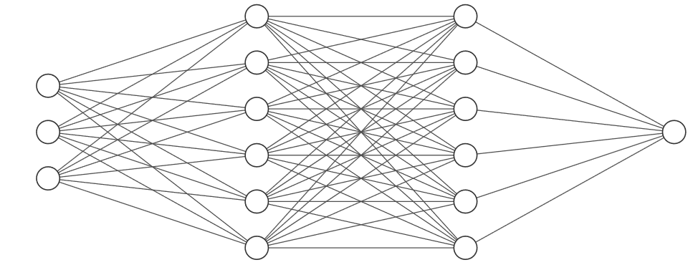
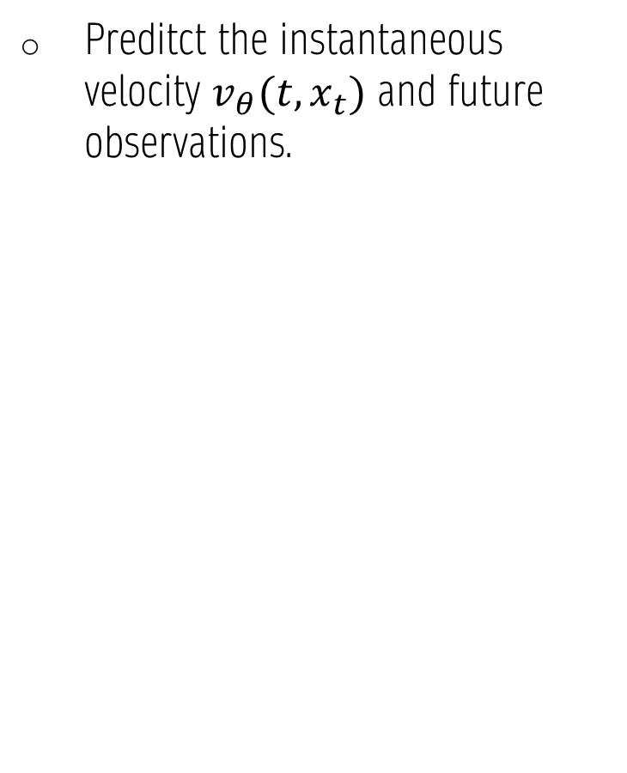
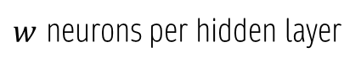
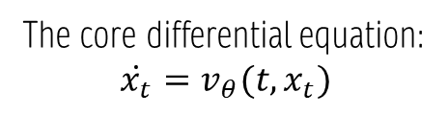
TFM Model Instance
Preditct the instantaneous velocity $v_{θ}(t, x_{t})$ and future observations.
The conventional approach:
Linear + SELU activation
IN
OUT
Hidden layers
$w$ neurons per hidden layer
The core differential equation:
$$\dot{x_{t}}=v_{θ}(t, x_{t})$$
[1] Xi Z. et al., Trajectory Flow Matching with Applications to Clinical Time Series Modeling
arXiv: 2410.21154v2 (2025)

Slide 7
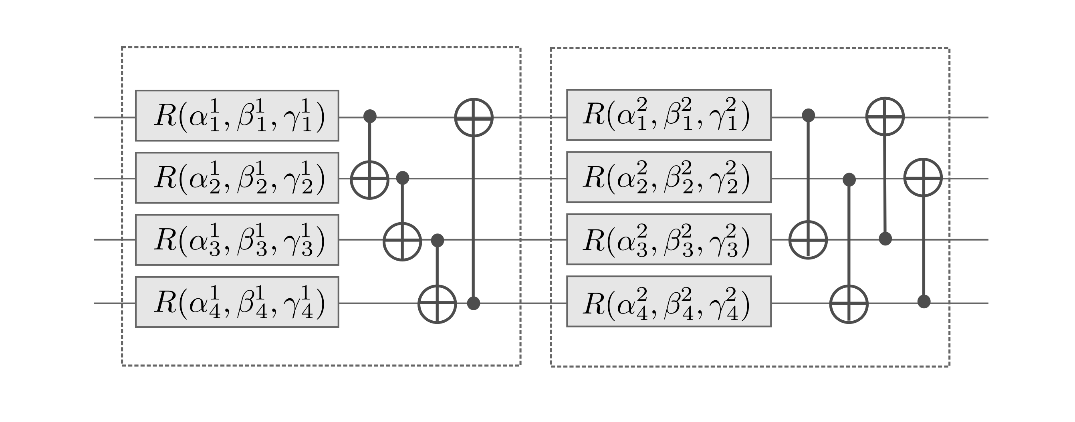
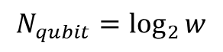
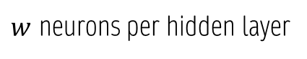
Where Quantum is applied
Quantum inspired approach:
Amplitude encoding + pairweise entanglements
MOTIVATION:
“Hidden layers” become layers of shallow variational quantum circuit.
Quantum systems encode correlations and interference naturally i.e. capturing complex and coupled nonlinearities.
Quantum dynamics are inherently continuous and unitary evolutions.
Linear + SELU activation
IN
OUT
Quantum circuits
Hidden layers
$w$ neurons per hidden layer
$$N_{qubit}=\log_{2}{w}$$

Slide 8

Advantages of using Quantum (inspired) method
Comparing to conventional methods:
Fewer trainable parameters
Faster convergence with less data
Less prone to overfitting
Uses quantum nonlinearity
→ effective activation
Uses quantum nonlocality
→ powerful feature entanglement
Comparing to Quantum Simulators
Faster inference
Lower cost
Suitable for algorithm validation and prototyping
Inspired by quantum!

Slide 9

Results

Slide 10
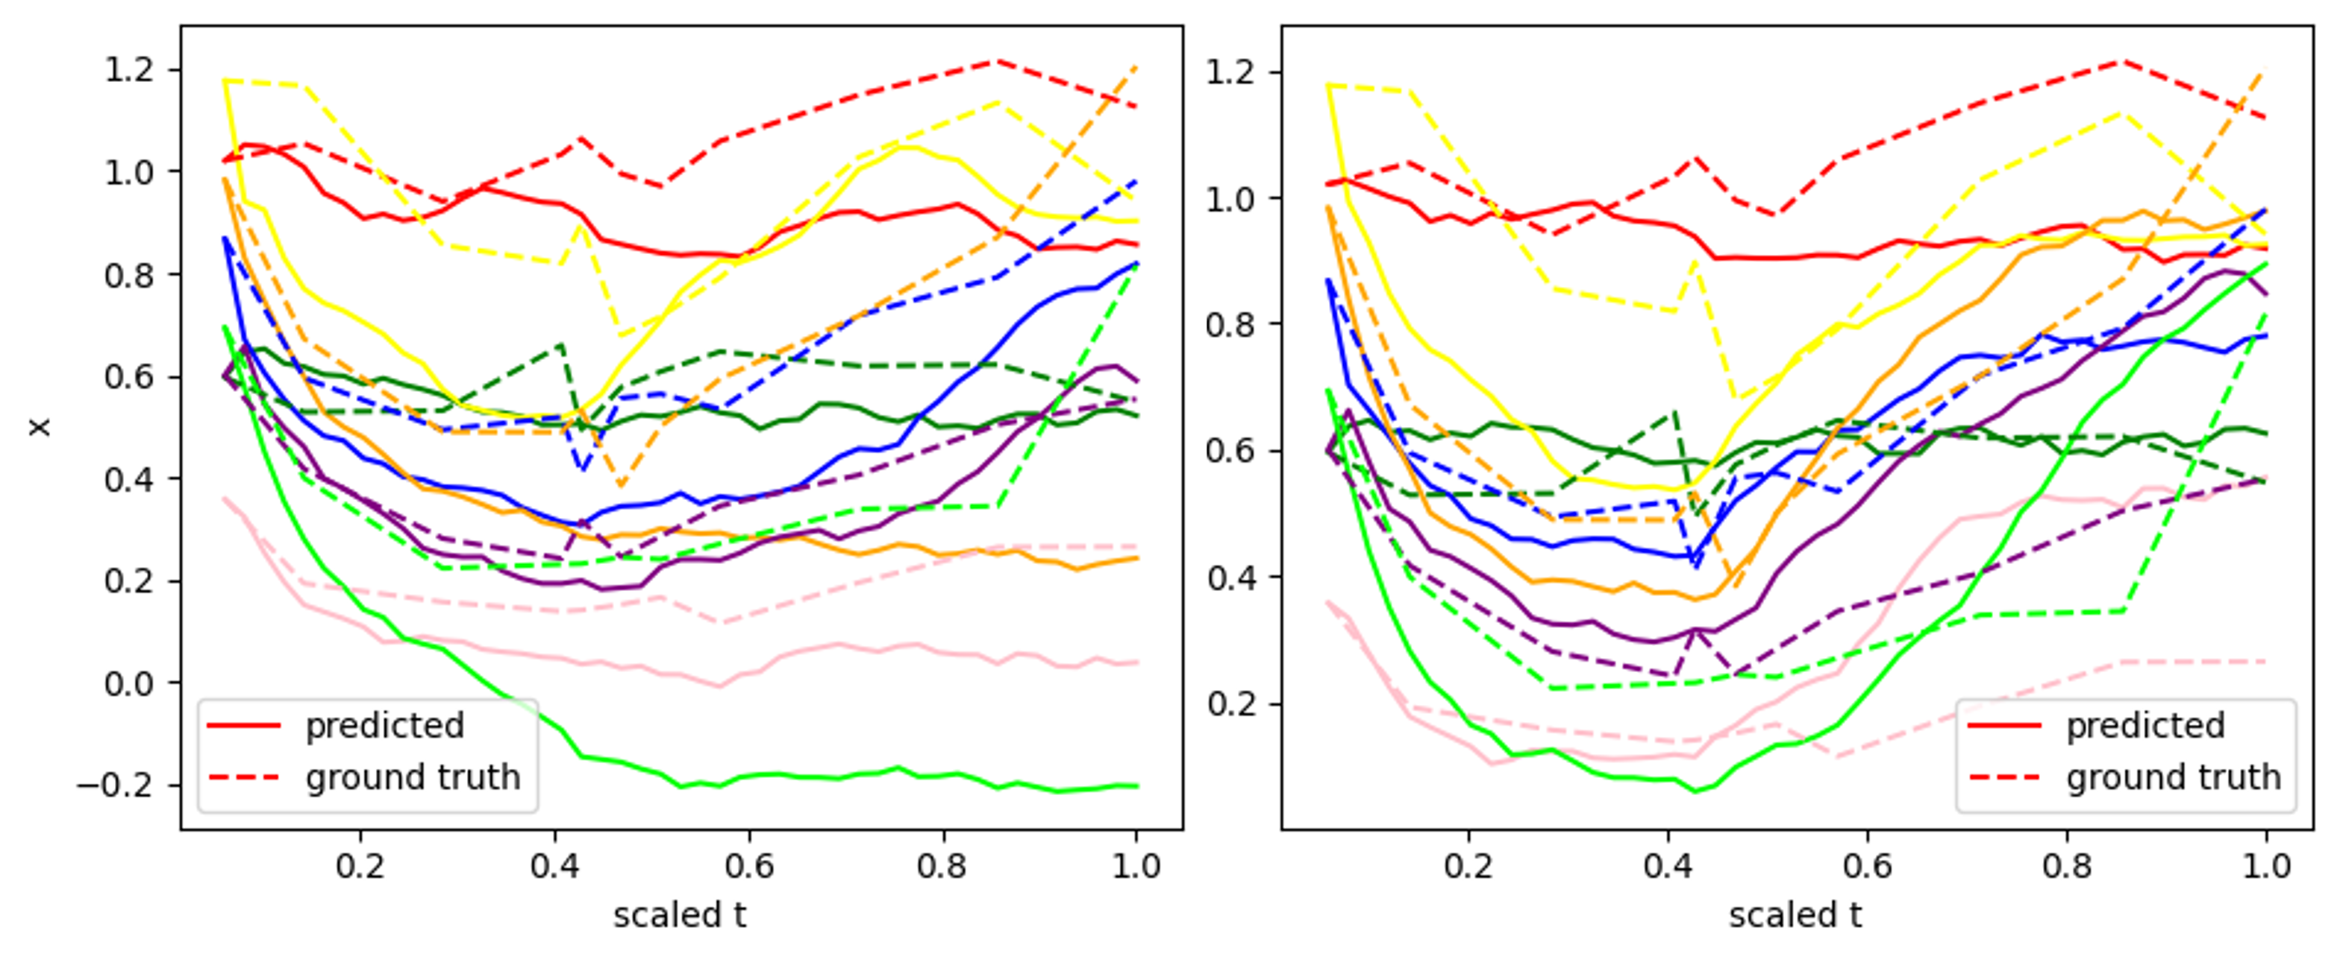
Classical vs. Quantum
Classical TFM
Quantum inspired TFM
Trainable parameters: 3,522 → 450
Validation MSE losses: 0.0708 → 0.0237

Slide 11



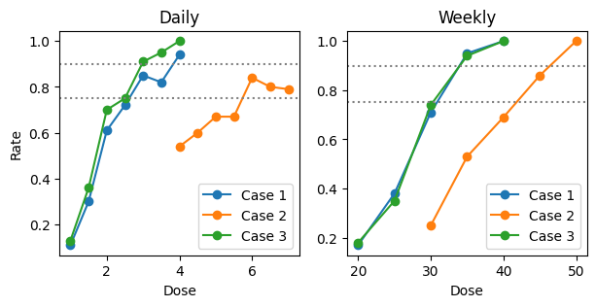



Generalizability & Scalability
Training dataset
Success rate vs dose level
Successfully suppressed bio-marker below the clinical threshold
Case 1: similar to the given data
Case 2: larger body weight
Case 3: avoid concomitant medication
Notes:
A good number of population has the biomarker suppressed below the clinical threshold.

Slide 12
Summary
Amplitude encoding + pairweise entanglements
Trajectory accuracy: MSE reduced from 0.07 to 0.02, i.e. by 70%.
Parameter efficiency: trainable parameters of QTFM has only about 10% of the classical TFM.
Linear + SELU activation
IN
OUT
Quantum circuits
Hidden layers

Slide 13
Plan for Phase 2
Completeness of existing algorithm
Extended experiments for uncertainty estimations.
Extension of Quantum inspired algorithm
Try neural ODE based training scheme.
Algorithmic benchmarking
Performance benchmarking of quantum inspired algorithms against classical baselines.
Fit PK and PD seperately, in addition to the joint modeling.
Exploration of new approach
Hardware efficiency enhancement.
Incorporate physics-informed constraintes.
Analyze computational efficiency, scalability, etc.

Slide 14

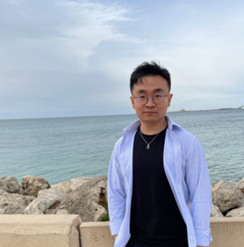

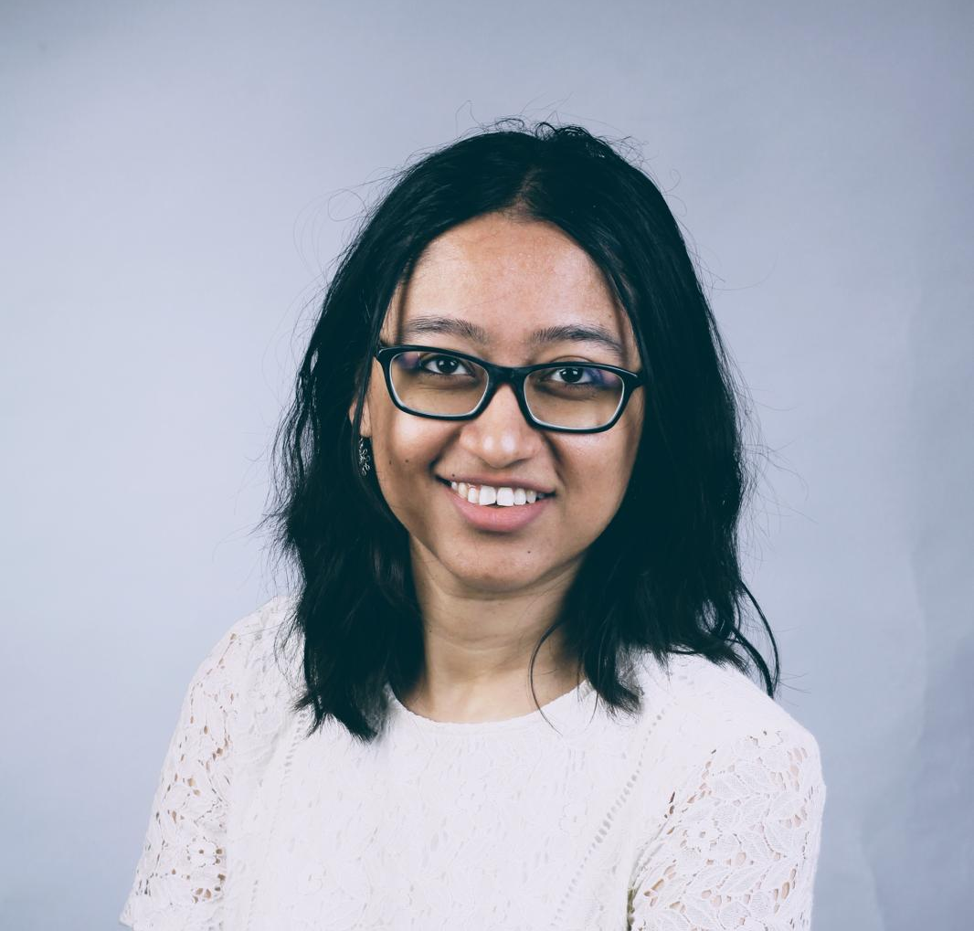
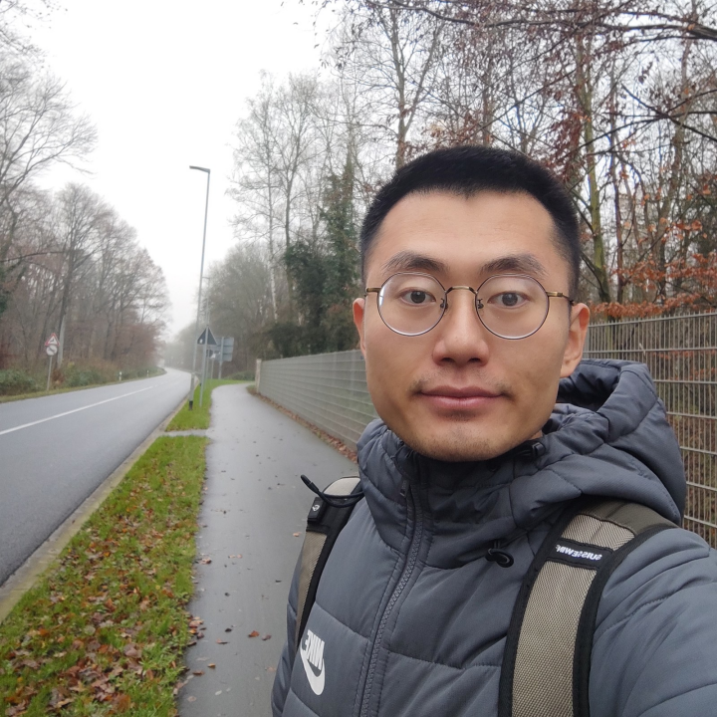
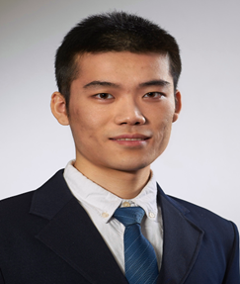
Thank You
Our Team
Dr. Zhuo Cao
Postdoc @ FZJ
Generative & explainable AI
LoCo Quantum @ LinkedIn
Dr. Mira Sharma
from RWTH Aachen
Quantum algorithm,
Spin qubits hardware & device modeling
Zhongyi Jiang
PhD student @ FZJ
Quantum algorithm, Superconducting qubits design & control
Ran Xue
PhD student @ RWTH Aachen
Quantum algorithm, spin qubits design & characterization

